Slide 1
TRADE: SOFTWARE DEVELOPMENT MODULE CODE:SWDVC301 LEVEL 3 SOFTWARE DEVELOPMENT A ,B & C
Module name: CONDUCT VERSION CONTROL
TRAINER:AZANI ABIZEYIMANA

Slide 2
Introduction
Let's imagine a company operating in many countries with many employees, in order to work they need to come to work in different departments. What happened during the COVID 19 pandemic? Are employees still working as usual? We all know it's not possible, because many companies were forced to close their doors because of the stay-at-home order. How would the company's employees continue to work and be aware of the changes in their company? How would they know about the changes in their institution? How would they keep up with the past?

Slide 3
There are different problems that may be raised, among them we can cite the followings:
Lack of collaboration
Storing versions
Restoring previous version once needed
Figuring out what happened in different branches
Problem of backup
In summary Is the reason why we need a version control system as developers in order to overcome those cited issues.

Slide 4
Learning outcome 1: Setup repository Indicative content 1.1: Definition of general key terms
Version control, also known as source control, is the practice of tracking and managing changes to software codes.
Version control systems are software tools that help software teams manage changes to source code over time.
As development environments have accelerated, version control systems help software teams work faster and smarter.

Slide 5
Before we dive into setting up version control, let me explain some common terms and commands used in version control so you understand what everything means!
Repo, short for Repository: it’s a storage space where you project or code resides in, it’s like a folder for your code!
There are two types of repos, local and remote.
1. Local Repo:
it is going to be on the machine (laptop or computer) where your code is stored at. Locally storing it means only you have access to the code and if your computer crashes or you lose that code, then it would be pretty hard to get it back.

Slide 6
2. Remote Repo:
it is going to be hosted on a website, like GitHub, for example, and your code here is accessible to not just you, but your whole team! If you lose your code on your computer, your code is still safe on here! This is a kind to iCloud storage.
Committ: saving code locally on your computer, to your local repo.
It is used to record the changes in the repository. It is the next command after the git add. Every commit contains the index data and the commit message
Push: The git push command is used to upload local repository content to a remote repository. Pushing is how you transfer commits from your local repository to a remote repo. It's the counterpart to git fetch , but whereas fetching imports commits to local branches, pushing exports commits to remote branches.
Pull : The git pull command is used to fetch and download content from a remote repository and immediately update the local repository to match that content.
Merge: when you use multiple branches, sometimes you want to combine the code in both branches, that is called a merge.

Slide 7
Clone
The git clone command is used to create a copy of a specific repository or branch within a repository.
Branch
A branch represents an independent line of development. Branches serve as an abstraction for the edit/stage/commit process.
Branch: it’s a like folder inside your repo, where you can organize what features are in which folder. Say, you and your teammate are working on an app together and you are working on feature 1 and they are working on feature 2. You can just have two different branches, feature1 and feature2 to keep your code more organized and prevent bugs!
Initialisation
The git init command creates a new Git repository. It can be used to convert an existing, unversioned project to a Git repository or initialize a new, empty repository. Most other Git commands are not available outside of an initialized repository, so this is usually the first command you'll run in a new project.
The git init command is the first command that you will run on Git. The git init command is used to create a new blank repository.

Slide 8
Git: is a free and open source distributed version control system designed to handle everything from small to very large projects with speed and efficiency.
Git is used to tracking changes in the source code, enabling multiple developers to work together on non-linear development.
Before diving deep, let’s explain a scenario before Git:
Developers used to submit their codes to the central server without having copies of their own
Any changes made to the source code were unknown to the other developers
There was no communication between any of the developers

Slide 9
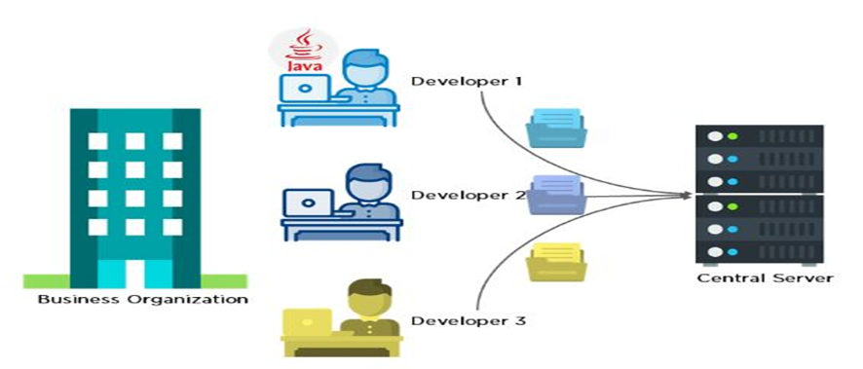

Slide 10
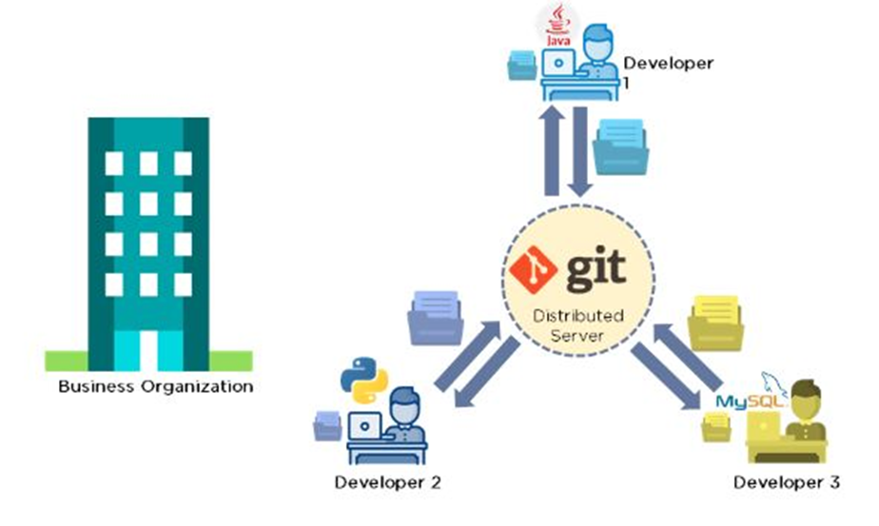
Now let’s look at the scenario after Git:
Every developer has an entire copy of the code on their local systems
Any changes made to the source code can be tracked by others
There is regular communication between the developers

Slide 11
Features of Git
Tracks history
Free and open source
Supports non-linear development
Creates backups
Scalable
Supports collaboration
Branching is easier
Distributed development

Slide 12
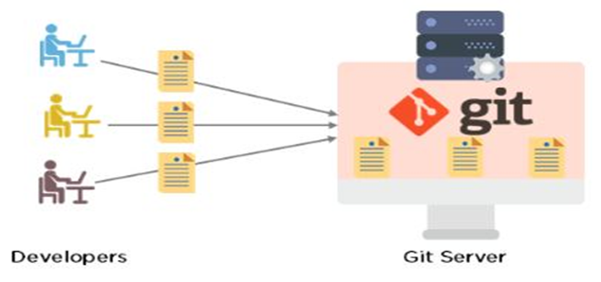

Slide 13
GitHub: is a code hosting platform for version control and collaboration. It lets you and others work together on projects from anywhere.
At a high level, GitHub is a website and cloud-based service that helps developers store and manage their code, as well as track and control changes to their code. To understand exactly what GitHub is, you need to know two connected principles:
Version control
Git

Slide 14
Terminal :
This is very much like the Terminal. It is a text-based interface that exists in every operating system as a program and is usually integrated in coding programs as well. By typing commands in the Terminal, you can access files, install programs, modify programs, get information about various things (for example, check things like package loss and speed of your internet) and do more or less everything else as well.
The quickest way to install, remove or update applications is through the Terminal. The Terminal is also referred to as the shell, command line, prompt, or command prompt.

Slide 15
Why the terminal?
The Terminal is a great tool for communication - and by that, I don’t mean for chatting with your best friend, but rather to access the internal CPU and other networks and computers. In coding, it is used primarily for:
Installing specific packages, updates, export and import your work to platforms like GitHub
Code testing
Error display
In short, it is a perfect way to be able to find information, manage installations and communicate with external services.

Slide 16
The End
Thank you for your kind attention

